Slide 1

19CSE314 Software Engineering
Overview of the course
Dr C.Arunkumar
Assistant Professor (SG), Dept of Computer Science and Engg
Amrita Vishwa Vidyapeetham, Coimbatore

Slide 2
About the course

Slide 3
Syllabus

Slide 4



Evaluation Pattern (TBC)
Evaluation Pattern
Theory
Project
Mid Term
Viva
End Sem
CA
Sprint 1
Sprint 2

Slide 5
Project
Form a team of FIVE (criteria – average CGPA = 7.5)
Minimum 1 girl and maximum 2 girls per group
Minimum 2 students of Cloud computing class
You will learn a bunch of tools
You will understand how really software development happens in a company
Rather how your future is going to be…

Slide 6
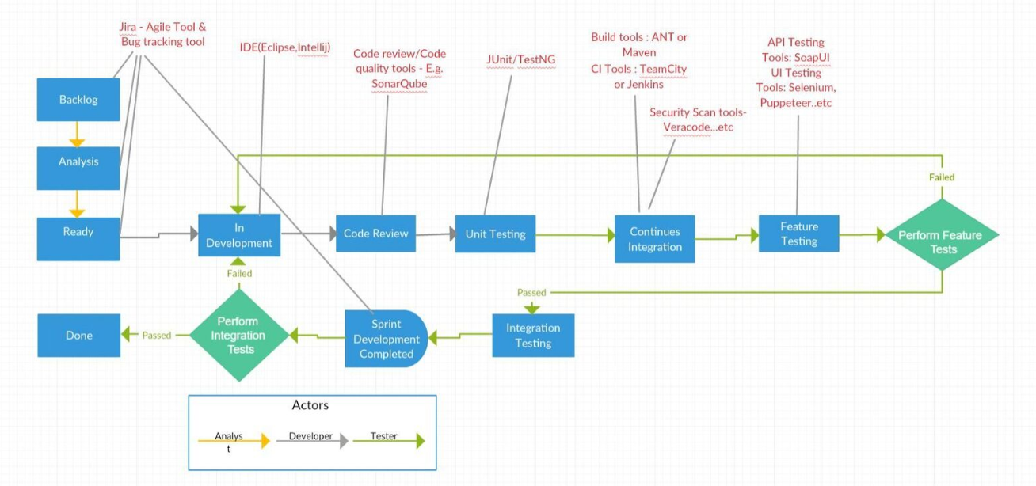
A snippet of the tools

Slide 7
Project (Not an exhaustive list)
Tool | Purpose
JIRA | Agile Tracking
GIT | Code repository
SonarQube | Static analysis
Cobertura | Code Coverage
Junit / Espresso | Unit Testing
Maven / ANT | Build
Jenkins | Continuous Integration
Selenium / Espresso | UI Testing

Slide 8
Exam Pattern
Mid Term – 10 marks
Viva – 10 marks
CA(Theory) – 10 marks
Sprint 1 – 20 marks
Sprint 2 – 20 marks
End sem online exam –15 marks
End sem viva – 15 marks

Slide 9
Course Outcomes
 | Course Outcome | BTL
CO 1 | Understand and apply the principles of software engineering | L2
CO 2 | Understand various software process models | L2
CO 3 | Apply the appropriate software design methodology for a given scenario | L3
CO 4 | Evaluate a system developed for real-world applications in Agile Mode | L5
CO 5 | Understand and implement various industry standards | L2

Slide 10
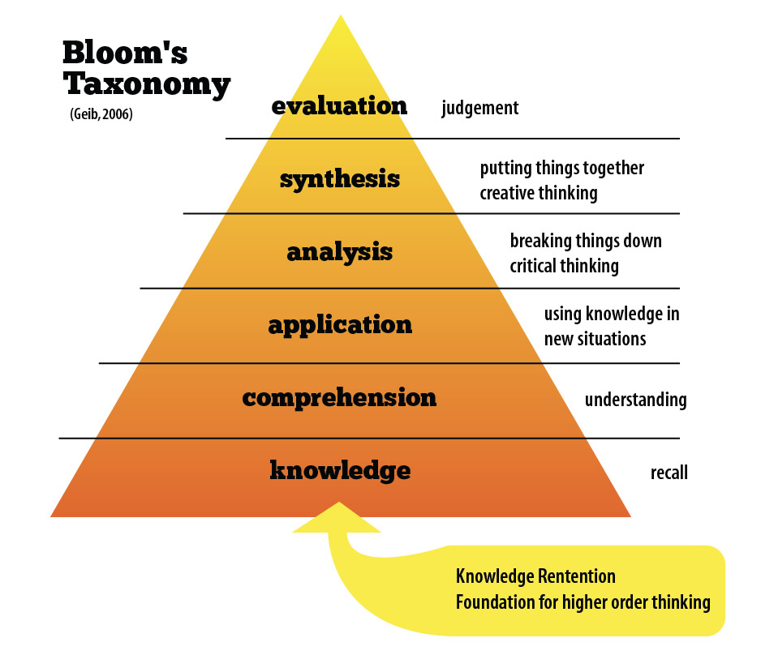
Course Outcomes
 | Course Outcome | BTL
CO 1 | Understand and apply the principles of software engineering | L2
CO 2 | Understand various software process models | L2
CO 3 | Apply the appropriate software design methodology for a given scenario | L3
CO 4 | Evaluate a system developed for real-world applications in Agile Mode | L5
CO 5 | Understand and implement various industry standards | L2

Slide 11
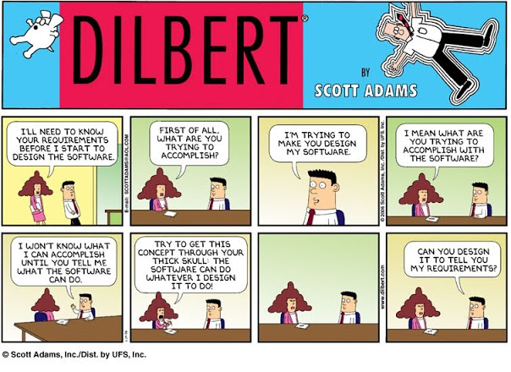
Textbook
Pressman R S, Bruce R.Maxim, “Software engineering - A Practitioner’s Approach”, Eighth Edition, Tata McGraw-Hill, 2014
Notes:
http://dilbert.com/dyn/str_strip/000000000/00000000/0000000/100000/00000/5000/800/105826/105826.strip.sunday.gif

Slide 12
Course communications
AUMS/One Drive/Whatsapp
All communications happen through this
Lecture materials and other items will be shared here

Slide 13
Quiz

Slide 14
What do you know about software engineering?

Slide 15
What are you expecting out of this course?

Slide 16
What is a software?

Slide 17
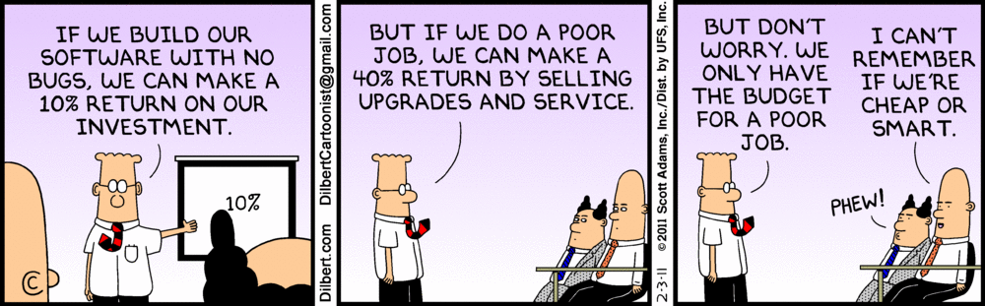
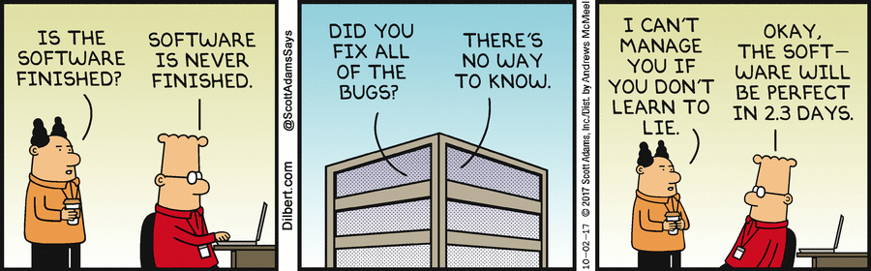
Dilbert comic on software engineering…

Slide 18
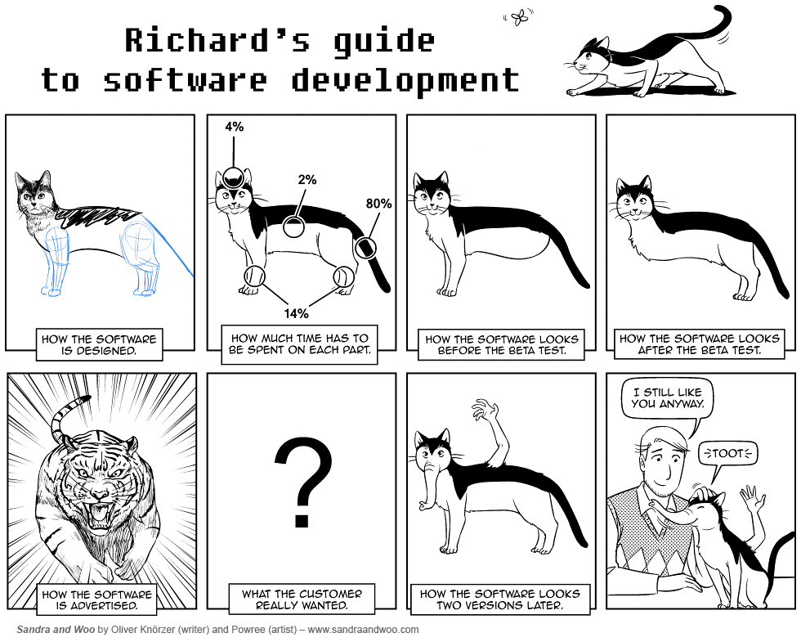

Slide 19
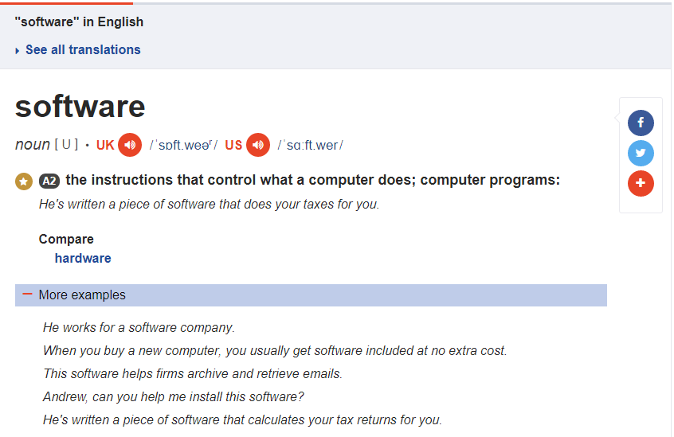
Cambridge dictionary says…

Slide 20
What is the process involved in developing a software?

Slide 21
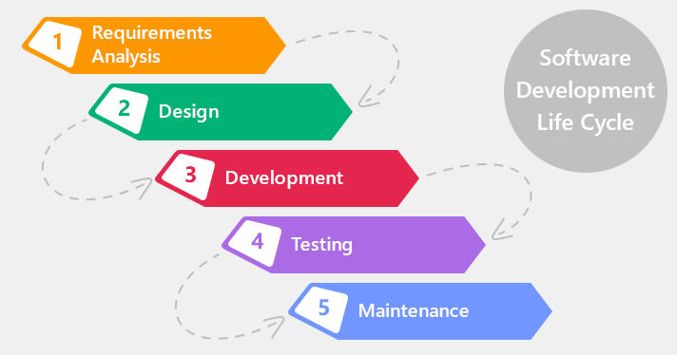
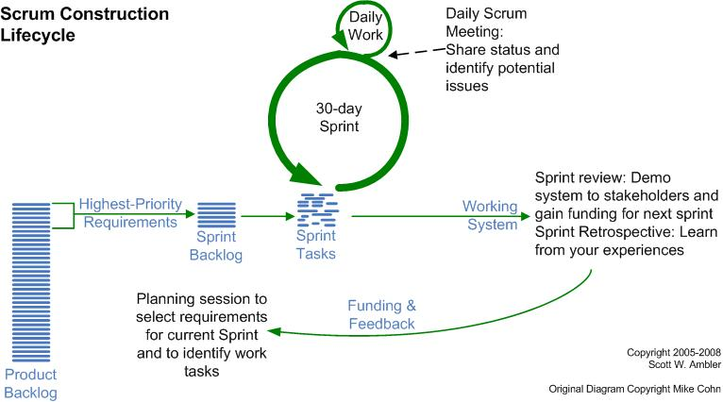

Slide 22
Why software development projects fail?

Slide 23

Why software Development projects fail?
Poor Communication
Not reviewing project progress on a regular basis
Unclear requirements
Unrealistic expectations
Internal Communication
External Communication
We will have periodic reviews ☺
Remember your DBMS project → What was the original project topic and what you end up doing? :P
Clients will always want their project delivered yesterday, at the lowest cost and highest quality. You don’t want to disappoint, so you assure them that everything is possible, including delivering yesterday.

Slide 24
Why software Development projects fail?
The absence of a good project manager
Better have a good manager in your project team
Not investing enough time for the project
Spend quality time for the project → It will definitely help
No end user involvement
Better talk to me more often ☺
Lack of quality testing
Testing is as important as development

Slide 25
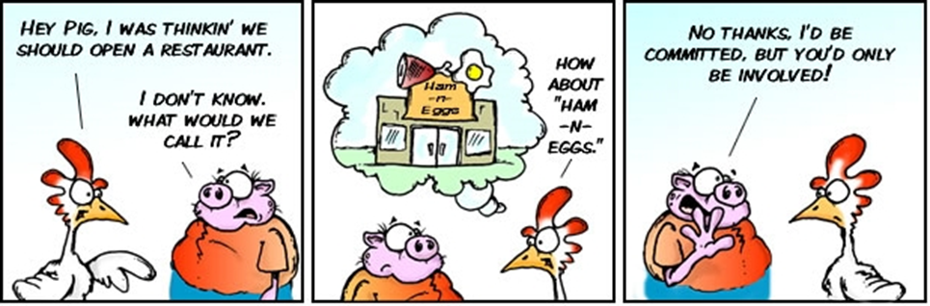
What roles are waiting for you?

Slide 26
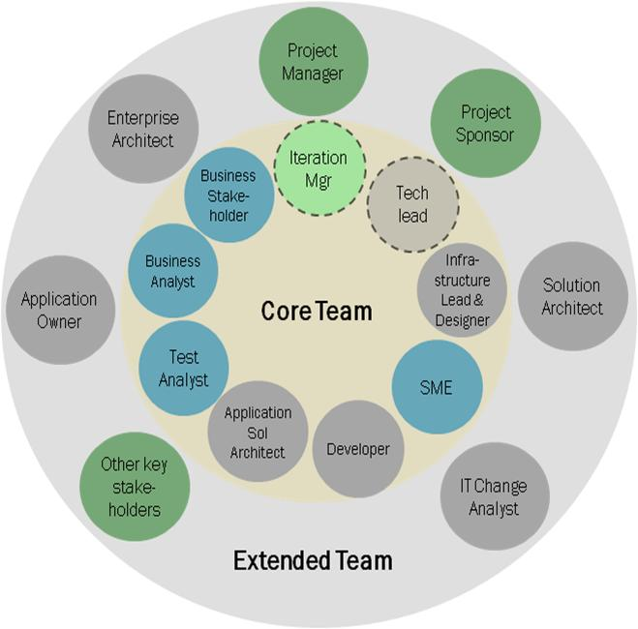

Slide 27
Next Session: Introduction to Software Engineering

